Slide 1
BUSINESS INTELLIGENCE-ETL
20XX
TEAM 5

Slide 2
WHAT IS BUSINESS INTELLIGENCE
Business intelligence (BI) refers to the procedural and technical infrastructure that collects, stores, and analyzes the data produced by a company’s activities.
BI is a broad term that encompasses data mining, process analysis, performance benchmarking, and descriptive analytics.

Slide 3
HOW BUSINESS INTELLIGENCE SYSTEMS are implemented
Step 1) Raw Data from corporate databases is extracted. The data could be spread across multiple systems heterogeneous systems.
Step 2) The data is cleaned and transformed into the data warehouse. The table can be linked, and data cubes are formed.
Step 3) Using BI system the user can ask quires, request ad-hoc reports or conduct any other analysis.

Slide 4
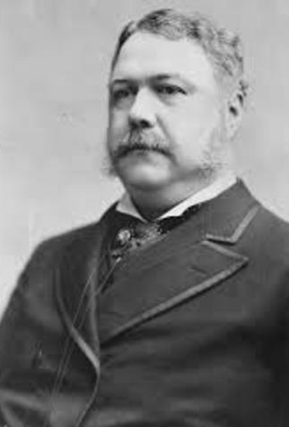
History of Business intelligence
The first use of the term “Business Intelligence” is widely attributed to Mr. Richard Miller Devens, in his book Cyclopædia of Commercial and Business Anecdotes

Slide 5
ETL
Extraction: It is used to read data from different sources both internally or externally.
Transformation: It is the process that converts the extracted data from its original form into the form which is needed.
Loading: It is defined to put data into warehouse.

Slide 6
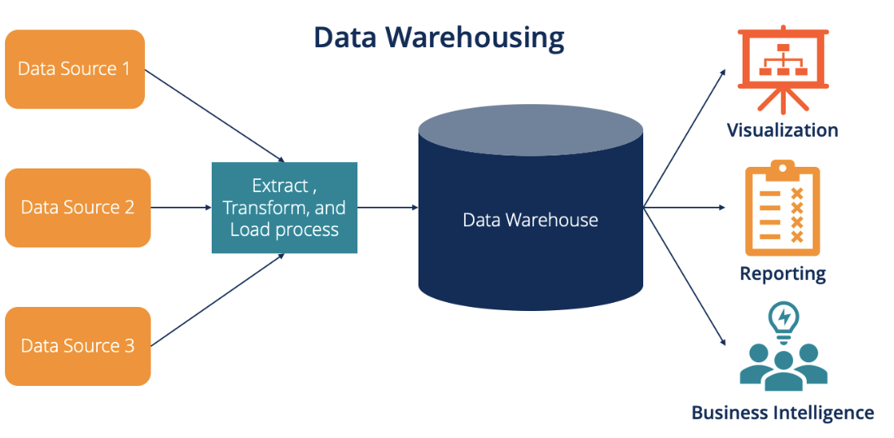
DATA WAREHOUSING
Data warehouse is a central repository or historical database which loads or extract data from different sources (databases) and stores in one single place called Data warehouse. it is very helpful for making informed or business decision.
Data warehousing should be done so that the data stored remains secure, reliable, and can be easily retrieved and managed.

Slide 7
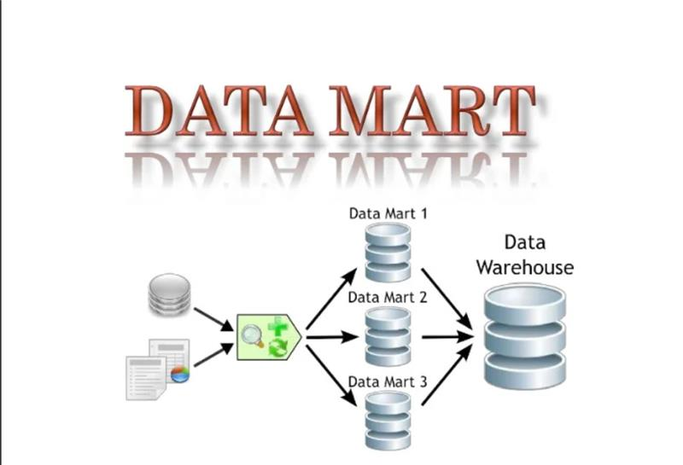
A data mart is a subset of a data warehouse focused on a particular line of business, department, or subject area.

Slide 8
Benefits of a data mart
Cost-efficiency:
Simplified data access:
Quicker access to insights:
Easier and faster implementation:

Slide 9
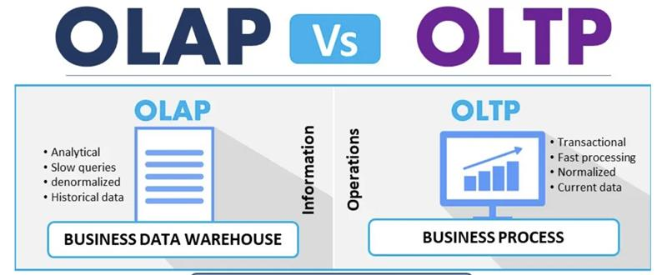
OLTP VS OLAP
OLAP-Online Analytical Processing, a category of software tools which provide analysis of data for business decisions.
OLTP-Online transaction processing shortly known as OLTP supports transaction-oriented applications in a 3-tier architecture.

Slide 10
references
ETL: https://www.mantralabsglobal.com/blog/etl-in-business-intelligence/
DATA MART: https://www.ibm.com/cloud/learn/data-mart
Business Intelligence Full Course | Business Intelligence Tutorial For Beginners | Simplilearn – YouTube
Part 13 Real Life Examples of Business Intelligence BI - YouTube
A Complete History of Business Intelligence | Toptal
A Brief History of Business Intelligence - DATAVERSITY

Slide 11

THANK YOU

